Slide 1


Brighton Web Develepment MeetUp Oct 2025 AI Agents and Evals in all languages
Craig West
https://craig-west.netlify.app/
Everything in this talk is included
in the repo
https://github.com/Python-Test-Engineer/brighton-web-development-meetup-oct2025

Slide 2
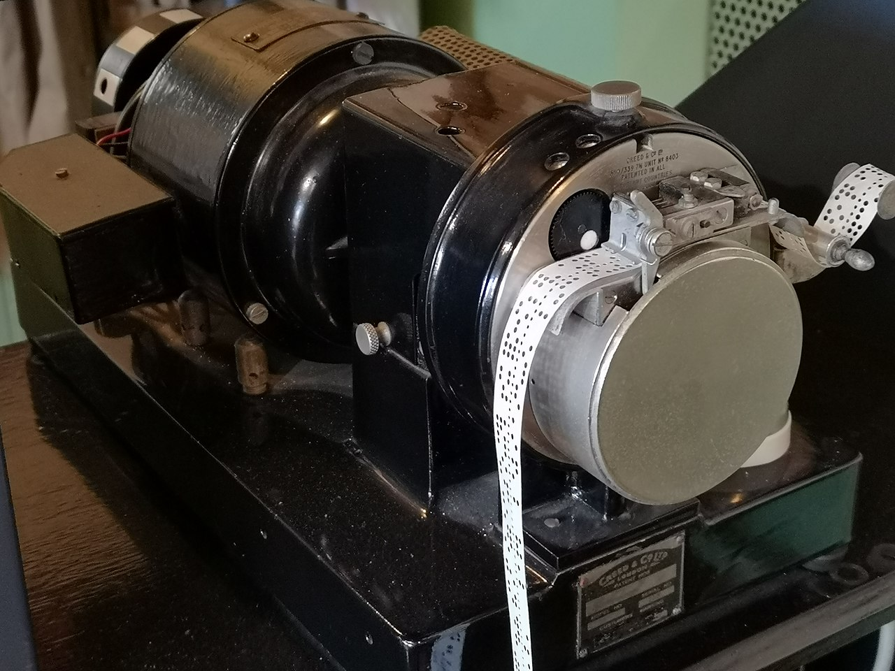



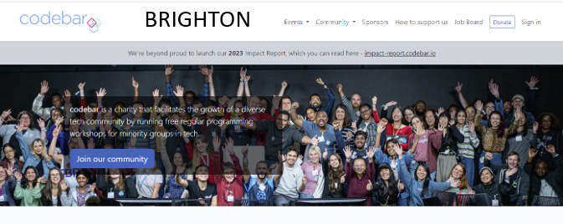
About me
I live about 1 mile north…

Slide 3
Desired Outcomes
To better understand the Agent Landscape, its terminology, basis and uses.
To demystify and simplify what an Agent is.
To see the value in Evals at all stages in dev/prod.
This is a ‘fly by’ rather than ‘deep dive’. The repo has more detailed examples and links to help you go further and deeper.

Slide 4
Why Evals?
Ensure TRUST and CAPABILITIES of our AGENTS so that somebody will pay for them.
EVALS === Check it works!
Would you pay for a substandard product?
Excellence in an evaluator will rub off on developer prompt code.
Can we save £ if we use a different LLM?

Slide 5
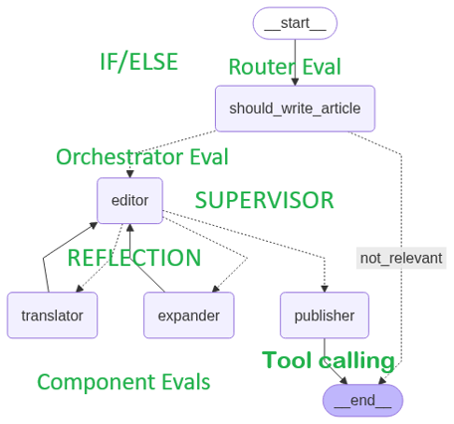
A sample app
Given an article title, determine if it is about AI.
Take title and create article of N words (EXPANDER)
In a specified language (TRANSLATOR)
Ensure article is not sensational (EDITOR)
PUBLISH = YES only if all three are YES
Publisher than works out price based on
deterministic and agentic rules.
This app could be a leaf of a larger app
– expanded next slide

Slide 7
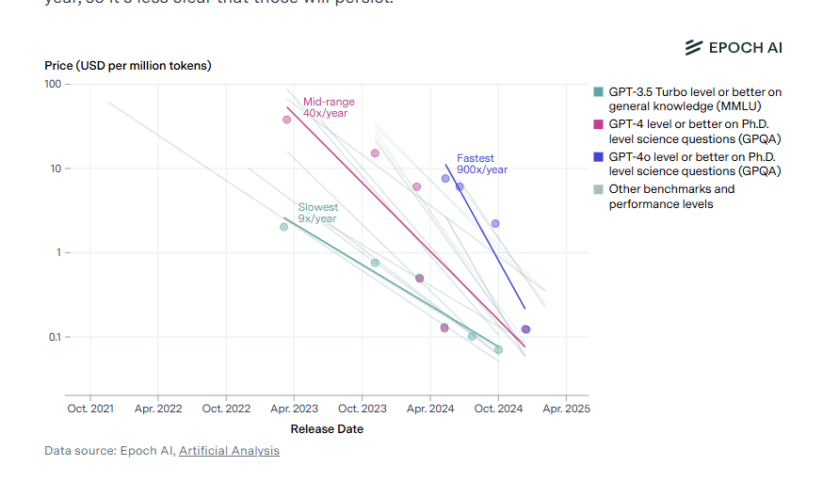
Model costs
Cost of a unit of ‘intelligence has dropped ~ 99% in last two years and is 10x a year (anecdotal)

Slide 8
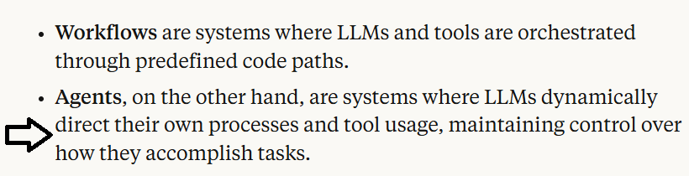
What is an AI Agent?
Many definitions and people opt for ‘Agentic Apps’
Anthropic

Slide 9


180-degree shift
No more difficult than what we do currently – just 180 degrees different
“It doesn’t get any easier – just different” - Anon

Slide 10
Raw code implementation of an Agent
Just one API endpoint – ‘AI as API’
Instructions are written on client side and sent with request
Use Natural Language

Slide 11
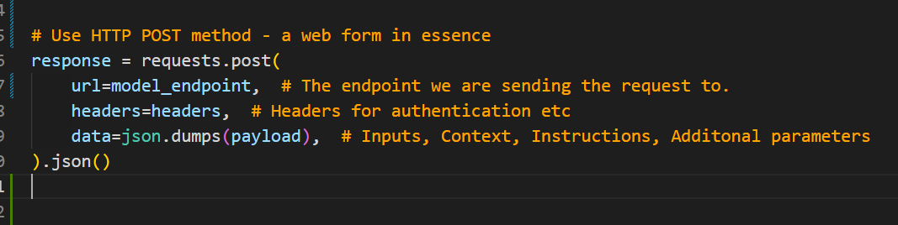
Raw code implementation of an Agent
We saw an example of a prompt earlier – ‘payload’
JS version next slide…s
Let’s look at 01_raw_post_request.py in the repo…

Slide 12
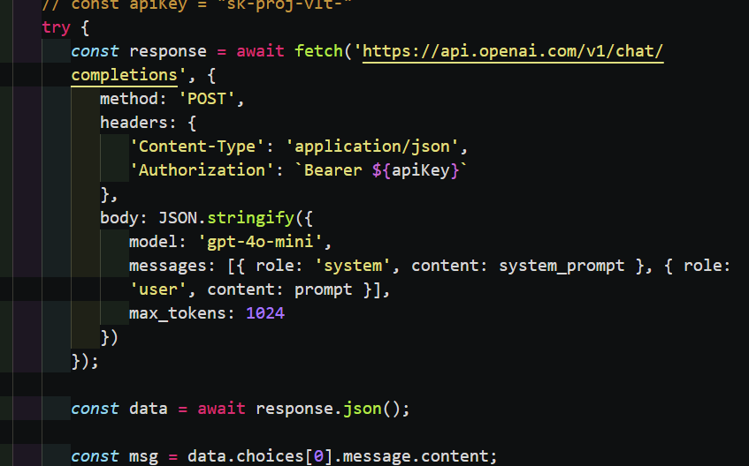
Most models trained on a list of messages, system and user.
INPUT
OUTPUT

Slide 13
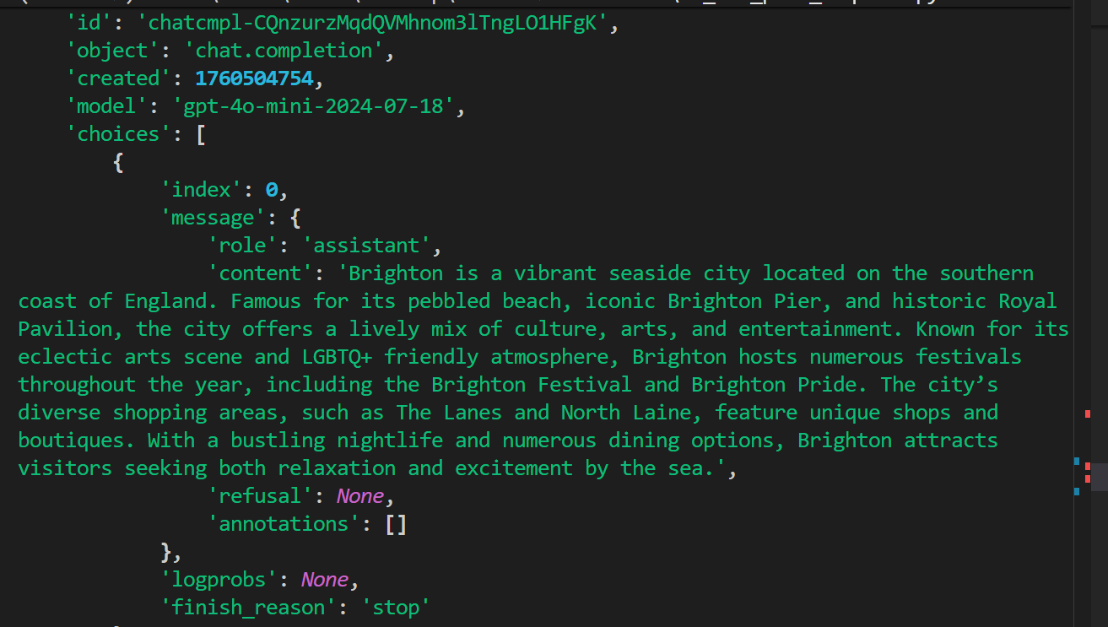
Tell me about Brighton……

Slide 14
Evals
We have input, output as well as meta data like prompt used, time taken, user_id, tech stack and so on.
Use our demo app ‘Article-Writer’ for example, all we need do is log these to CSV…

Slide 15
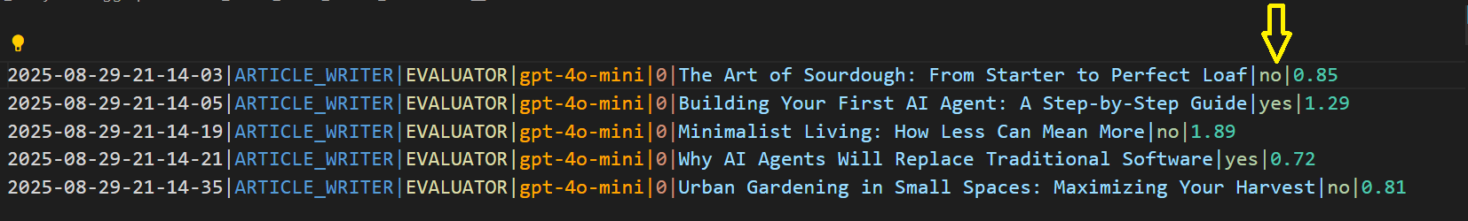
We can think of an LLM call as a mathematical function – f(x) -> y, along with meta data of the surrounds just prior to the function cal
We can monitor in real time too.
Date|App|Agent-Model|Temp|Input|IOutput|Time

Slide 16
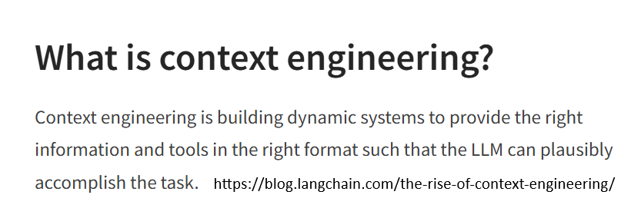
Context Engineering (Prompt)

Slide 17
Supplying more Context (information)
“Tell me about Data Analytics and here is some data from our company, please analyse…”
This is context engineering where we supply appropriate context for the Agent.
RAG is Retrieval Augmented Generation and is RETRIEVING extra content from a range of sources for the prompt – not just Vector Databases.

Slide 18
What is Tool/Function calling?
Tool/Function Calling –
adding more context/info on demand
“Tell me about Data Analytics and here is some data…
Also compare our share price with {company X}…”
We don’t know this information at time of the request as it will vary with each query.
We need a tool/function the Agent can use to get the share price… “tool/function calling”

Slide 19
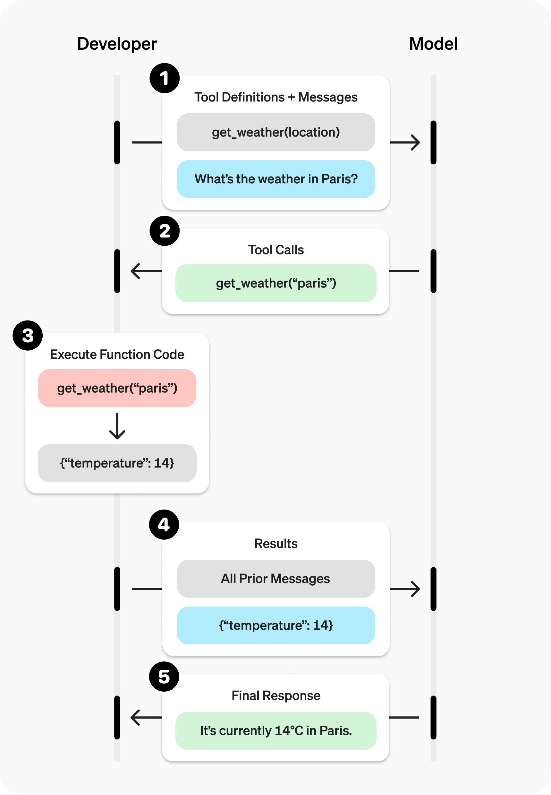
What is Tool/Function calling?
In our INSTRUCTIONS we can add:
Here are some useful tools/functions that may be of help at run time.
Let me know which you want to run and with what arguments.
I will run them on my machine and then send this extra CONTEXT back to you (reflection – see image)
02.1_prompt.md has the prompt
02.2_demo_tool_calling.py
03_openai_tool_calling.html
Enlarged on next slide

Slide 20
What is Tool/Function calling?

Slide 21
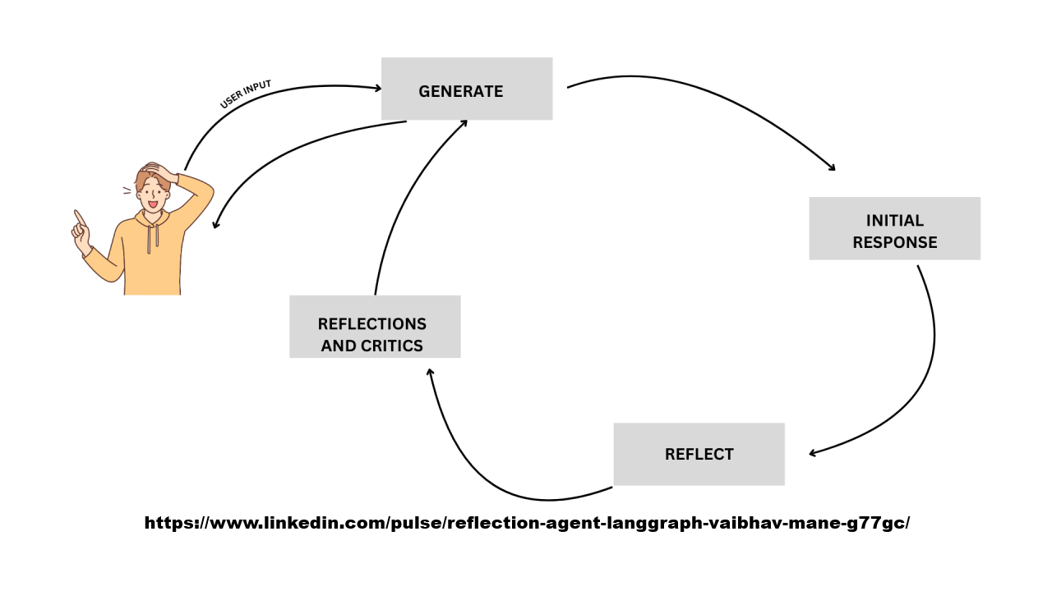
Reflection Pattern - looping
We can use different LLMs too…

Slide 22
Reflection – output sent back in next input
We ask Agent to write some code for us, then pass the response to a critique and the response from that to a final one to combine the two.
“Generate a Python implementation of imputing missing values in a Pandas DataFrame with the mean of the column.
Ensure there are plenty of comments explaining the code.”
04_demo_reflection.ipynb -> three files:
04.1_code.md
04.2_critique.md
04.3_final.md (OUTPUT of one Fn INPUT to next Fn)

Slide 23
A sample app
Given an article title, determine if it is about AI.
Take title and create article of N words (EXPANDER)
In a specified language (TRANSLATOR)
Ensure article is not sensational (EDITOR)
PUBLISH = YES only if all three are YES
Publisher than works out price based on
deterministic and agentic rules.
This app could be a leaf of a larger app
– expanded next slide

Slide 24
RAG & TOOL TRAJECTORY EVALS (1)
Retrieval Augmented Generation
INPUT | OUTPUT | CONTEXT | GROUND_TRUTH
Was it worth getting CONTEXT? How well does it relate to GROUND_TRUTH?
Did the question get answered – correctly, completely, no additions, accurately?
There are many libraries that evaluate this giving F1 scores etc but in code they will use LLM as a JUDGE

Slide 25
RAG & TOOL TRAJECTORY EVALS (2)
00_prompt_md
"Score as a string between '0' and '3'. "
"0: No relevance/Not grounded/Irrelevant - The context/answer is completely unrelated or not based on the context. "
"1: Low relevance/Low groundedness/Somewhat relevant - The context/answer has minimal relevance or grounding. "
"2: Medium relevance/Medium groundedness/Mostly relevant - The context/answer is somewhat relevant or grounded. "
"3: High relevance/High groundedness/Fully relevant - The context/answer is highly relevant or grounded.“
“4:Step-by-step reasoning explaining how the retrieved context aligns with the user's query. “
“5: Consider the relevance of the information to the query's intent and the appropriateness of the context in providing a coherent and useful response.”

Slide 26
RAG & TOOL TRAJECTORY EVALS (3)
TOOL TRAJECTORY
The Pricing Agent uses one of two tools – random between a range and word count/assessment that then is passed on to another agent to give a PRICE RATING like ‘good value’, ‘expensive’.
In EVALS05 we can observe the agent in action using dependent tools.

Slide 27
What is the Model Context Protocol (MCP)?
We have seen how we can write tools for the Agent to discover and call as needed.
What about tools others have created?
How can an Agent discover what tools are available, how to use them with what ever arguments are needed and how to execute them? (like when we go to NPM/PyPi to get libraries)

Slide 28
What is the Model Context Protocol (MCP)?
This is the Model Context Protocol for Agents to be able to do this.
In essence, an Agent can find a list of tools we have given it, with these tools able to inform an Agent what they are and how to use them.
The Agent runs the npx/pipx to download and run them in a separate process.

Slide 29
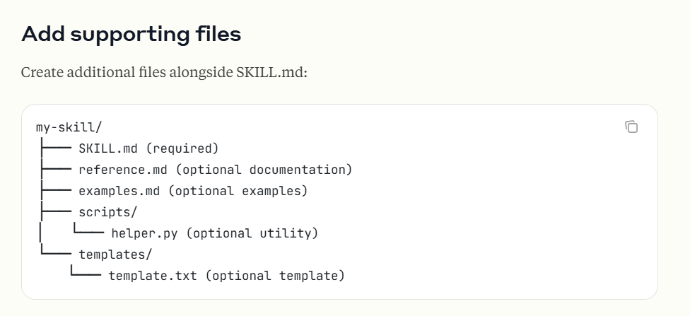
Claude Skills

Slide 30
Future
Craig West
https://craig-west.netlify.app/
https://evaluating-ai-agents.com/
Contact links on the sites
Always have 10 mins to answer questions…

